Slide 1
“The Remarkable Journey towards Equality and Civil Marriage for Lesbian and Gay People in Ireland”
Presentation to Centre for Criminal Justice & Human Rights, UCC
Kieran Rose, GLEN Chair
Advisory Board, Centre for Theory of Change, New York
March 2014

Slide 2
From Criminalisation to Civil Marriage
1993 – Decriminalisation on the basis of equality
1998 – Powerful Equality legislation
2010 – Marriage-like Civil Partnership Act
2011 – Finance Act; on a par with marriage
2014 – Children and Family Relationships Bill; equality based
2015 – Referendum on the Right to Marry

Slide 3
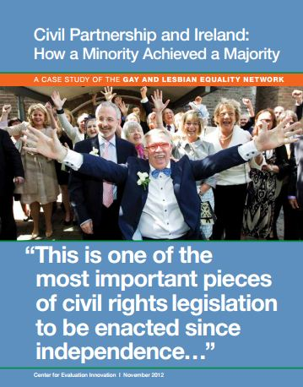

Slide 4
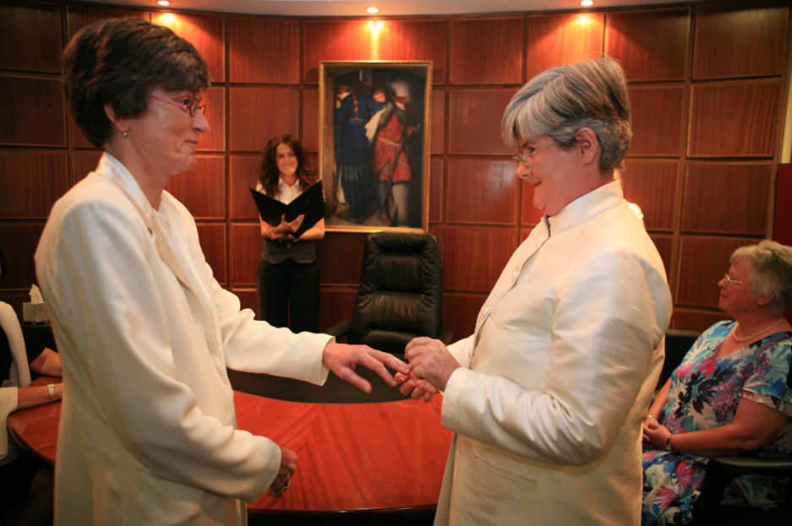
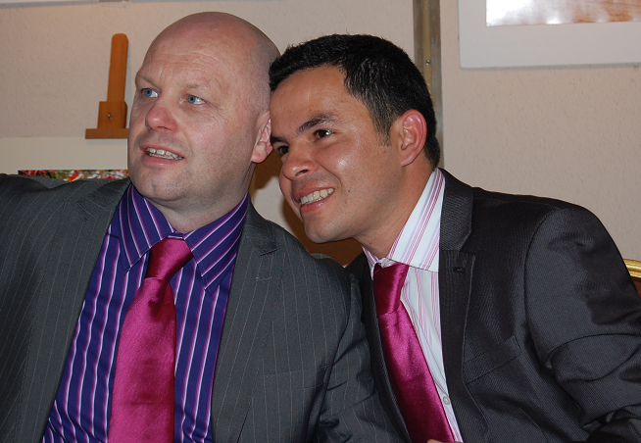
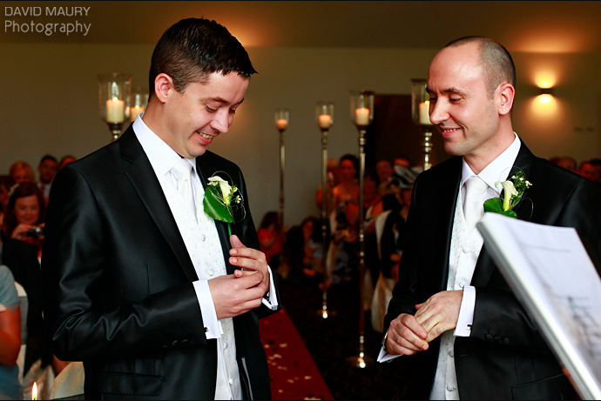
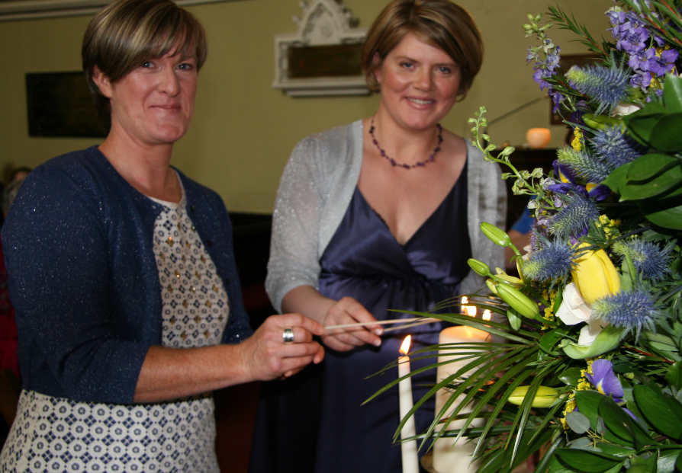

Slide 5
GLEN consistent policy is that Civil Marriage is the ultimate equality option
But…we also campaigned for and welcomed progress towards that goal
Couples urgent and immediate needs were at the core of our concerns and our campaign
GLEN deliberately decided to take legislative route through Oireachtas
Goes to the heart of differences in strategies of different marriage campaigns

Slide 6
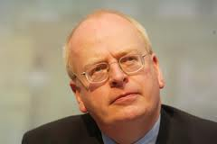
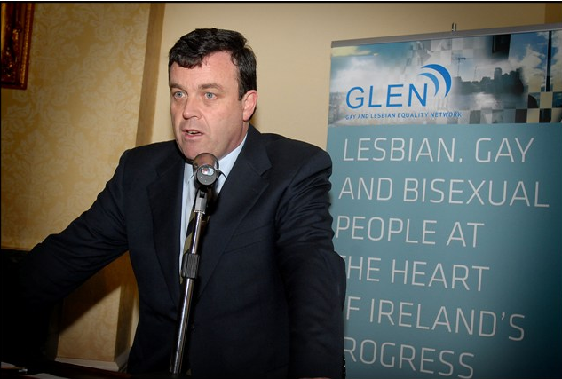
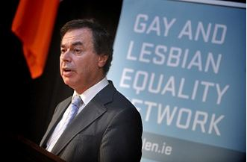
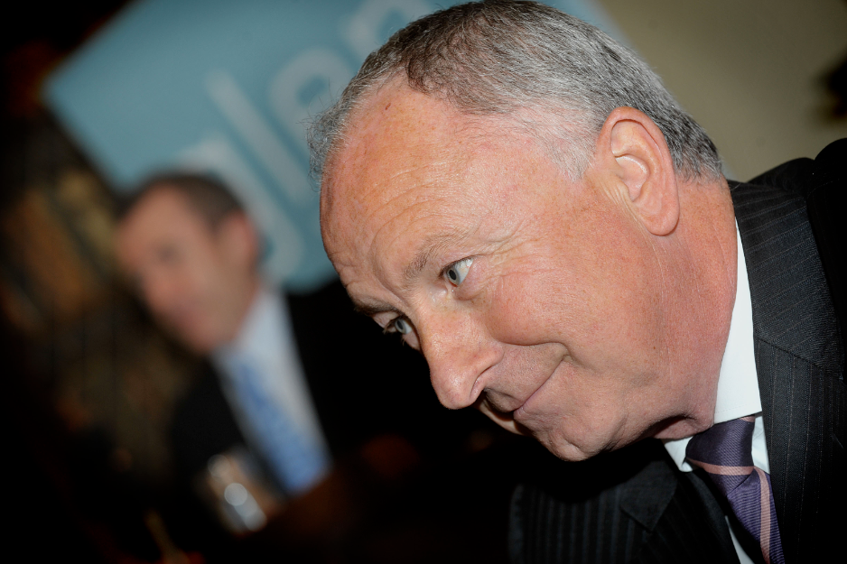
Engagement with three Governments & four Ministers for Justice

Slide 7
The Remarkable Journey to Equality....
... Through a Recession

Slide 8
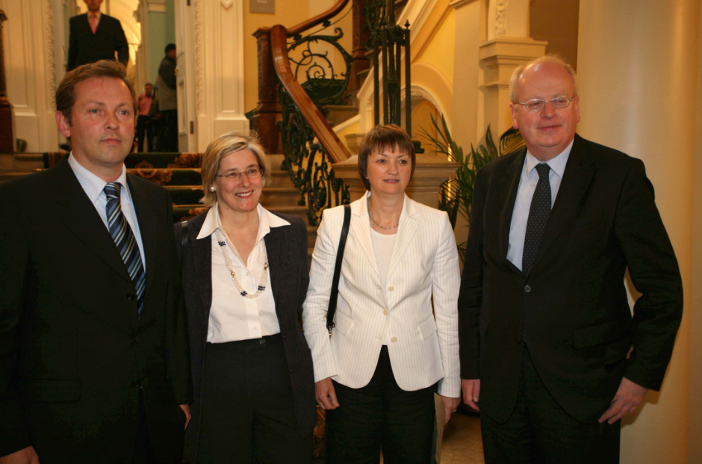
2006: Colley Group Report was critical foundation
A key part of our consensus-building strategy: ‘independent’ ‘official’ support.
Arose from engagement with Minister Michael McDowell
GLEN’s Eoin Collins persuaded Group to set out
Civil Marriage as only equality option.
Or full civil partnership if marriage
constitutionally vulnerable
KAL Case loses in High Court

Slide 9
2006: Labour Party say to GLEN “we have a Civil Unions Bill; will you support?”
Labour say Referendum necessary
Labour Bill based on Colley
Our inflection point
We strongly support their bill; it was widely
welcomed; Dáil visitors gallery packed;
Government votes against
However, agenda is advanced strongly

Slide 10
2007: General Election: Commitments in every party manifesto
FF/Green Programme for Government on basis of Colley but also pending Supreme Court Appeal in KAL Case
(appeal dropped in 2012)

Slide 11
Critical to get that pending KAL appeal delay removed
Urgent needs of lesbian and gay couples are our priority
Noel Whelan …
“[Senator Jim] Walsh and others in the Parliamentary Party who oppose civil partnership for same-sex couples were clearly relying on the traditional strategy of those who oppose reform – delay.”

Slide 12
Role of Advocacy Group?
Critic? Hurler on the ditch?
Or Active engagement and Participation?
Taking part responsibility for in Delivery?
With elected representatives, key departmental officials etc.
Persuasion: to win as a minority,
you must build a majority
Minister Brian Lenihan removes delay
2008 Heads of Bill published

Slide 13
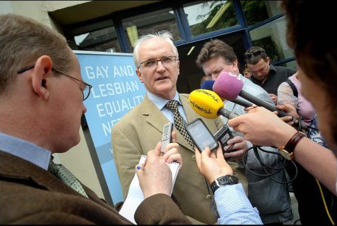
2009: Civil Partnership Bill Published
GLEN strongly welcomes
Strong opposition from those opposed to civil
partnership on basis that too close to marriage
30 FF Backbenchers sign motion to Government
Cardinal Brady and Catholic Church strongly oppose
Strongly opposed by those whose position is ‘marriage or nothing’. Bill torn up at Dublin Pride.

Slide 14
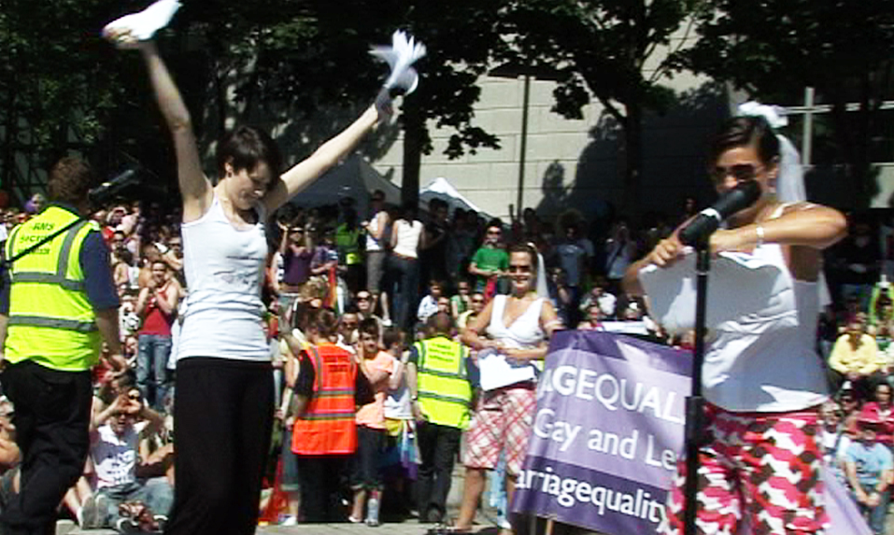

Slide 15
A Campaign for Civil Marriage... became a Campaign against Civil Partnership?
Refusal to deal with facts .. that overwhelming legal and political opinion considered a civil marriage bill to be unconstitutional
Prepared to block fundamental and immediate progress for couples … that Civil Partnership would bring
In favour of the ultimate answer … at some indeterminate time in the future
Akin to religious certainties ...

Slide 16
“hard cases make bad law” … we were told when we raised couples in dire need of immediate answers
“Civil Partnership would remove momentum for Civil Marriage” ..
“Just introduce amendment to Civil Registration Act” … still waiting for a Private members Bill
The Civil Partnership to Civil Marriage strategy was successful
“Civil Marriage or nothing” … couples would have nothing now .. and far less chance of a successful Referendum

Slide 17
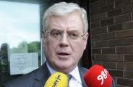
Eamonn Gilmore’s 2009 strategy for achieving marriage building on civil unions:
“In the meantime, there are immediate, unmet,
needs that should not be postponed until such
a referendum is held. Waiting for the best
should not be a reason for delay in bringing
about the better.”

Slide 18
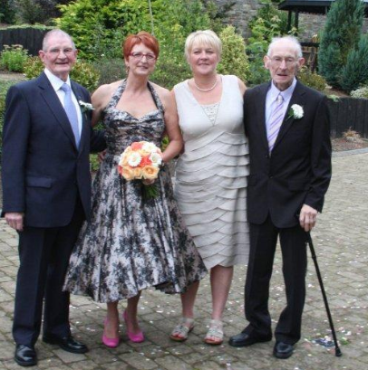
Role of Advocacy Group?
The Need to Hold Your Nerve
“it would be unconscionable to say to couples, ‘we know that the bill will provide you with legal answers to your urgent problems, but we will oppose it because it is not marriage’” GLEN chair Kieran Rose at public information meeting on Bill.
Eleanor, Teresa and their Dads, Enniscorthy 2011

Slide 19
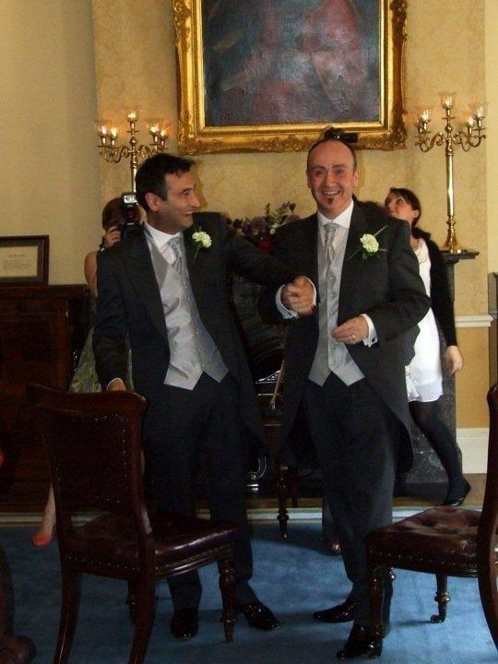
Joan Hart, PA Consulting (from GLEN evaluation):
Our clear understanding is that, had GLEN persisted with its preferred option (i.e. full marriage), civil partnership was at risk of going off the political agenda completely. GLEN understood this risk and made a calculated decision to pursue civil partnership and the legislative protections it brought.
Ministers and officials have many competing priorities
Alper and Paul, Dublin 2011

Slide 20
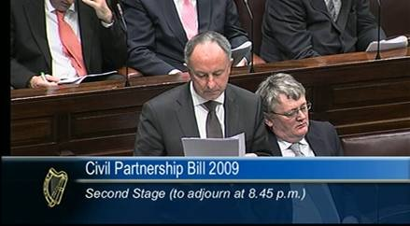
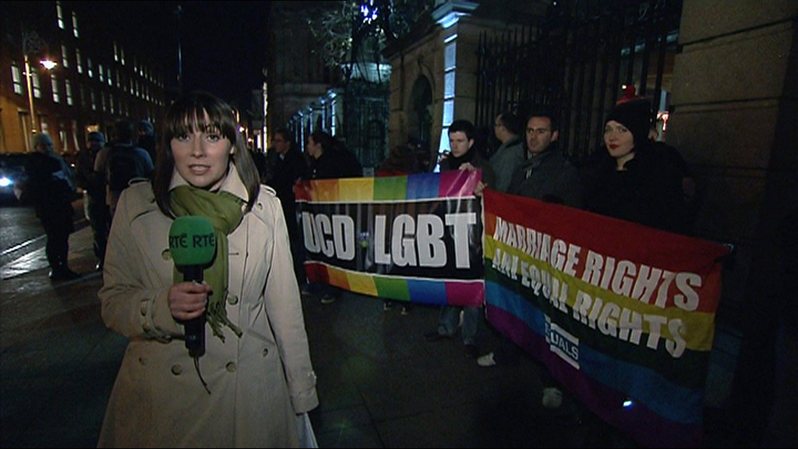
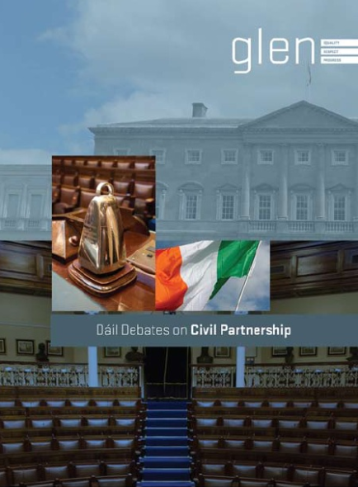
2009 & 2010: Civil Partnership proceeds through Oireachtas
Powerful speeches in the Dáil and Seanad
‘Conscience’ clause spoiler rejected by Minister Ahern and all Parties
Praise works
‘A victory all can be proud of.’
How you win is as important as what you win

Slide 21
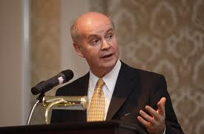
Minister Pat Carey, speaking after passage of the Bill:
“There was never an element of inevitability about the introduction of civil partnerships in this country…To be honest, when the Bill was introduced, many of us thought it would not get through the Dáil without a vote, and there was a serious danger that it wouldn’t get through at all…I must pay tribute to the work of GLEN for your advocacy, your quiet advocacy and your powers of persuasion.”

Slide 22
Civil partnership provides almost all the rights and responsibilities of marriage, with the exception of parenting, which will be addressed by the Children and Family Relationships Bill.
Other differences are in areas that are not materially significant in order to ‘fireproof’ from Constitutional challenge.
Equality implemented across full range of government services including immigration, social welfare and tax.

Slide 23
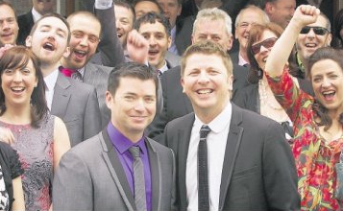
April 5th 2011 First Civil Partnership:
1,303 Civil Partnerships to end Dec 2013
Every County in Ireland
All ages
From Ireland and 72 Countries
Foreign same-sex marriages and civil partnerships automatically treated as CPs from Jan 2011.
Hugh Walsh and Barry Dignam, Dublin 2011

Slide 24
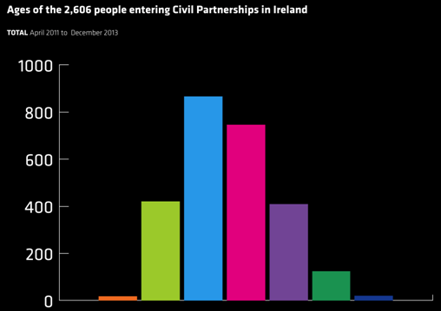
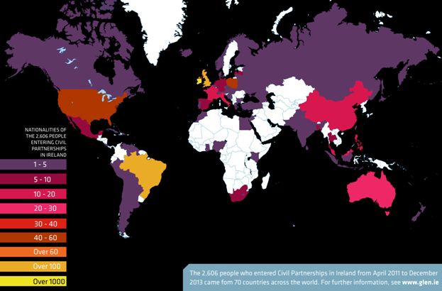

Slide 25
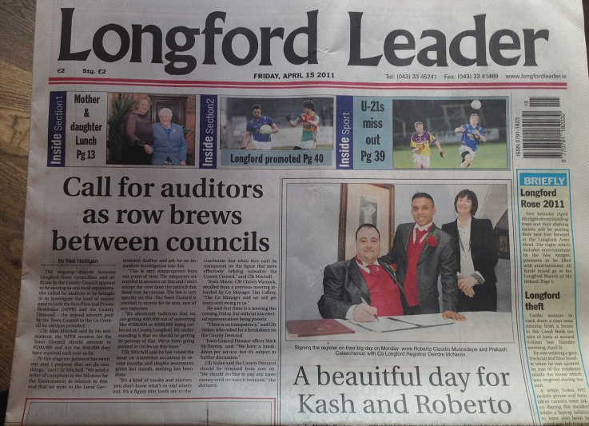
Momentum for Marriage Intensified:
Major cultural shift
GLEN steps up our campaign for civil marriage in 2012
Longford Leader Editorial, July 2012
“For many people the term ‘civil partnership’ has become interchangeable with the term marriage… As far as they are concerned they are attending the ‘wedding’ of their gay or lesbian friends….The reality is that the tide of public opinion has just shifted towards an acceptance of gay marriage”.

Slide 26
Campaign against Civil Partnership; 160 Differences?
Noel Whelan, July 2012:
“Forcing the issue in a haphazard way is counterproductive. Emphasising or…overstating the gap between civil marriage and civil partnership now only serves to endanger the success of a future referendum campaign but also runs the risk of disrespecting those who have entered into CP by somehow suggesting they are complicit in their own discrimination.
The opposite is the case because those couples are pioneers who have helped to radically alter the perception of lesbian and gay relationships across the country.”

Slide 27
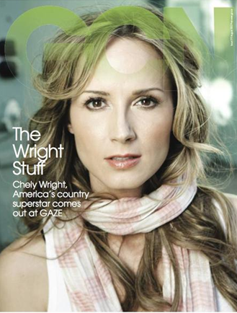
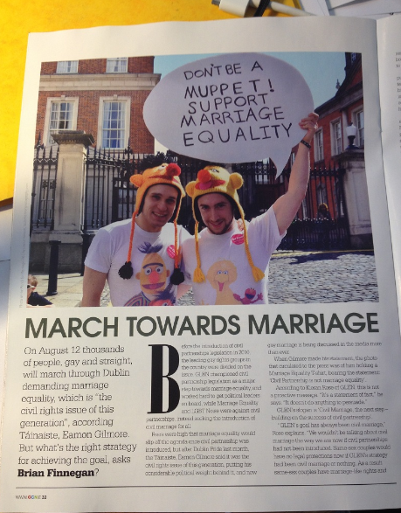
GCN Editorial July 2012:
“Gay and lesbian couples who have civil partnerships are the ones driving the acceptance of marriage equality home”.

Slide 28
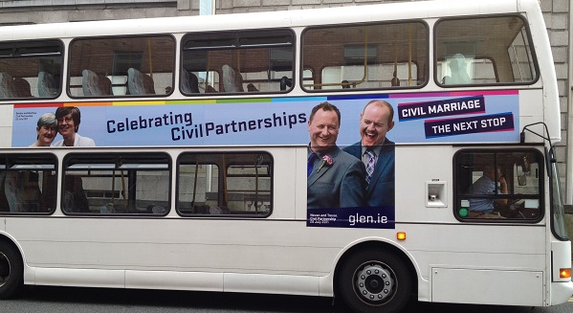
Fine Gael and Taoiseach and all political parties support Civil Marriage
All marriage-like statutory rights and responsibilities in place…
… next incremental step is Civil Marriage and Full Constitutional Equality
Referendum is there to be won… convincingly
If we convince a good majority to go out and vote ‘Yes to Marriage’
‘Yes to Equal Citizenship under the Constitution’
If we have the right Campaign Strategy
…building on the success of civil partnerships
Thank You!
chair@glen.ie
www.glen.ie

